Slide 1
Advanced BKT
February 11, 2013

Slide 2
Classic BKT
Not learned
p(T)
Learned
p(L₀)
p(G)
1-p(S)
correct
correct
Two Learning Parameters
p(L₀) Probability the skill is already known before the first opportunity to use the skill in problem solving.
p(T) Probability the skill will be learned at each opportunity to use the skill.
Two Performance Parameters
p(G) Probability the student will guess correctly if the skill is not known.
p(S) Probability the student will slip (make a mistake) if the skill is known.

Slide 3
Extensions to BKT
Largely take the form of relaxing the assumption that parameters vary by skill, but are constant for all other factors

Slide 4
Advanced BKT
Beck’s Help Model
Pardos Individualization of L_{o}
Moment by Moment Learning
Contextual Guess and Slip

Slide 5
Beck et al.’s (2008) Help Model
p(T|H)
Not learned
Learned
p(T|~H)
p(L₀|H),
p(L₀|~H)
p(G|~H), p(G|H)
1-p(S|~H)
1-p(S|H)
correct
correct

Slide 6
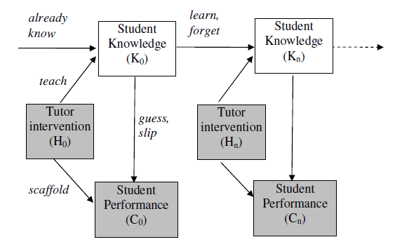
Beck et al.’s (2008) Help Model

Slide 7
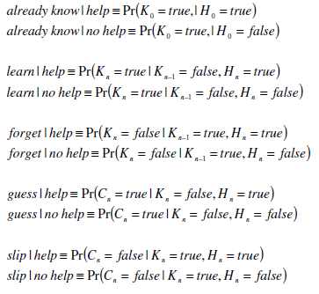
Beck et al.’s (2008) Help Model

Slide 8
Beck et al.’s (2008) Help Model
How to fit? The same way as regular BKT
Parameters per skill: 8
Effect on future prediction: slightly worse

Slide 9
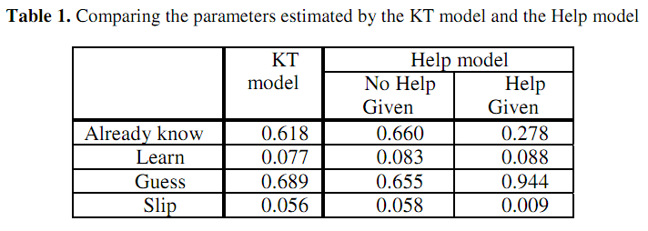
Beck et al.’s (2008) Help Model
What do these parameters suggest?

Slide 10
Advanced BKT
Beck’s Help Model
Pardos Individualization of L_{o}
Moment by Moment Learning
Contextual Guess and Slip

Slide 11
BKT-Prior Per Student (Pardos et al., 2010)
p(L₀) = Student’s average correctness on all prior problem sets
Not learned
p(T)
Learned
p(G)
1-p(S)
correct
correct

Slide 12
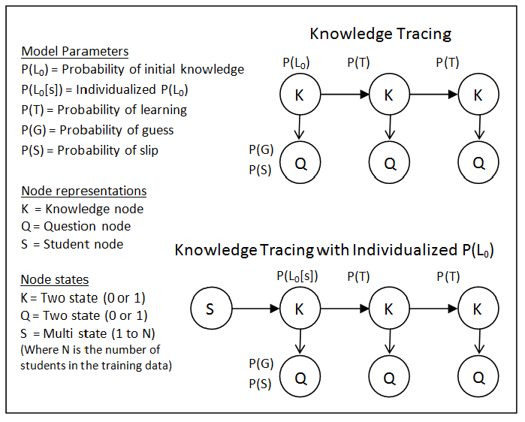
BKT-Prior Per Student (Pardos et al., 2010)

Slide 13
Pardos et al.’s (2010) Prior Per Student model
Much better on ASSISTments and Cognitive Tutor for genetics (Pardos et al., 2010; Baker et al., 2011)
Much worse on ASSISTments (Gowda et al., 2011)

Slide 14
Advanced BKT
Beck’s Help Model
Pardos Individualization of L_{o}
Moment by Moment Learning
Contextual Guess and Slip

Slide 15
Moment-By-Moment Learning Model (Baker, Goldstein, & Heffernan, 2010)
Probability you Just Learned
p(J)
Not learned
p(T)
Learned
p(L₀)
p(G)
1-p(S)
correct
correct

Slide 16
P(J)
P(T) = chance you will learn if you didn’t know it
P(J) = probability you JustLearned
P(J) = P(~L_{n} ^ T)

Slide 17
P(J) is distinct from P(T)
For example:
P(L_{n}) = 0.1
P(T) = 0.6
P(J) = 0.54
P(L_{n}) = 0.96
P(T) = 0.6
P(J) = 0.02
Learning!
Little Learning

Slide 18
Labeling P(J)
Based on this concept:
“The probability a student did not know a skill but then learns it by doing the current problem, given their performance on the next two.”
P(J) = P(~L_{n} ^ T | A₊₁₊₂ )
*For full list of equations, see Baker, Goldstein, & Heffernan (2010)

Slide 19
Breaking down P(~L_{n} ^ T | A₊₁₊₂ )
We can calculate P(~L_{n} ^ T | A₊₁₊₂ ) with an application of Bayes’ theorem
P(~L_{n} ^ T | A₊₁₊₂ ) =
Bayes’ Theorem: P(A | B) =
P(A₊₁₊₂ | ~L_{n} ^ T) * P(~L_{n} ^ T)
P (A₊₁₊₂ )
P(B | A) * P(A)
P(B)

Slide 20
Breaking down P(A₊₁₊₂ )
P(~L_{n} ^ T ) is computed with BKT building blocks {P(~L_{n}), P(T)}
P(A₊₁₊₂ ) is a function of the only three relevant scenarios, {L_{n}, ~L_{n} ^ T, ~L_{n} ^ ~T}, and their contingent probabilities
P(A₊₁₊₂ ) = P(A₊₁₊₂ | L_{n}) P(L_{n})
+ P(A₊₁₊₂ | ~L_{n} ^ T) P(~L_{n} ^ T)
+ P(A₊₁₊₂ | ~L_{n} ^ ~T) P(~L_{n} ^ ~T)

Slide 21
Breaking down P(A₊₁₊₂ | L_{n}) P(L_{n}): One Example
P(A₊₁₊₂ = C, C | L_{n} ) = P(~S)P(~S)
P(A₊₁₊₂ = C, ~C | L_{n} ) = P(~S)P(S)
P(A₊₁₊₂ = ~C, C | L_{n} ) = P(S)P(~S)
P(A₊₁₊₂ = ~C, ~C | L_{n} ) = P(S)P(S)
skill | problemID | userID | correct | L_{n-1} | L_{n} | G | S | T | P(J)
similar-figures | 71241 | 52128 | 0 | .56 | .21036516 | .299 | .1 | .067 | .002799
similar-figures | 71242 | 52128 | 0 | .21036516 | .10115955 | .299 | .1 | .067 | .00362673
similar-figures | 71243 | 52128 | 1 | .10115955 | .30308785 | .299 | .1 | .067 | .00218025
similar-figures | 71244 | 52128 | 0 | .30308785 | .12150209 | .299 | .1 | .067 | .00346442
similar-figures | 71245 | 52128 | 0 | .12150209 | .08505184 | .299 | .1 | .067 | .00375788
(Correct marked C, wrong marked ~C)

Slide 22
Features of P(J)
Distilled from logs of student interactions with tutor software
Broadly capture behavior indicative of learning
Selected from same initial set of features previously used in detectors of
gaming the system (Baker, Corbett, Roll, & Koedinger, 2008)
off-task behavior (Baker, 2007)
carelessness (Baker, Corbett, & Aleven, 2008)

Slide 23
Features of P(J)
All features use only first response data
Later extension to include subsequent responses only increased model correlation very slightly – not significantly (Baker, Goldstein, & Heffernan, 2011)

Slide 24
Features of P(J)
Argument could be made that using BKT probabilities (L_{n}) in the prediction of the label (~L_{n} ^ T) is wrong
We consider this to be valid – theoretically important part of model is the T, not the L_{n}
The model maintains a 0.301 correlation coefficient even without L_{n} or L_{n}-1

Slide 25
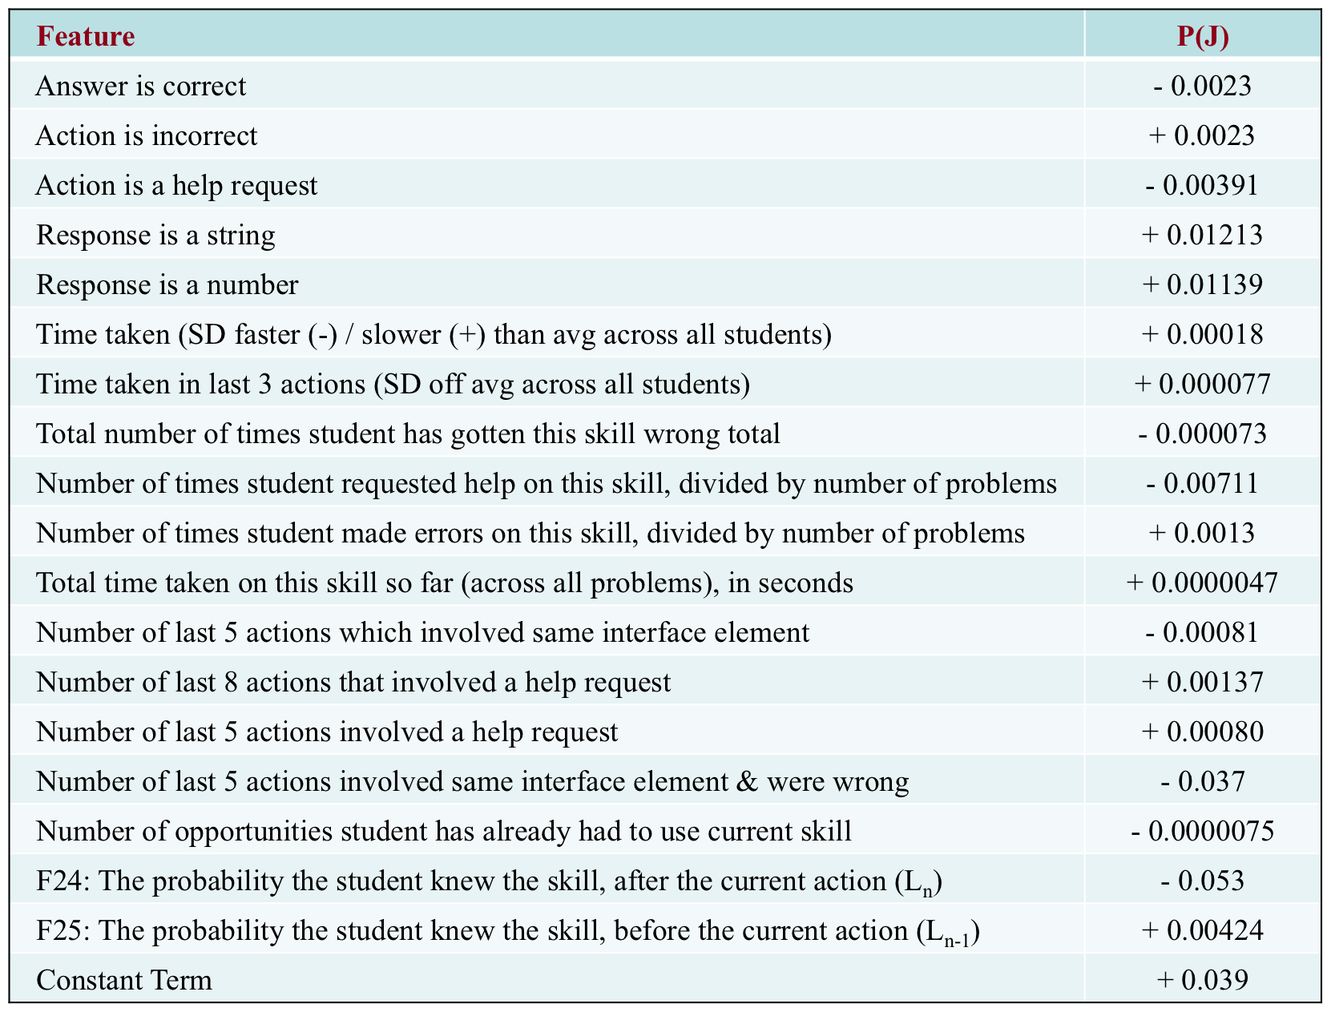
The final model

Slide 26
Interpretation
P(J) is higher following incorrect responses
People learn from their mistakes
However, P(J) decreases as the total number of times student got this skill wrong increases
Might need intervention not available in the tutor

Slide 27
Interpretation
P(J) is lower following help requests
P(J) is higher when help has been used recently, i.e. in the last 5 and/or 8 steps

Slide 28
Replication
We replicated this result in another intelligent tutor, ASSISTments (Razzaq et al., 2007)
Correlation between models and labels: 0.397

Slide 29
Model use
Does learning in intelligent tutors have more of a character of
gradual learning (such as strengthening of a memory association – cf. Newell & Rosenbloom, 1981; Heathcote, Brown, & Mewhort, 2000)
or learning given to “eureka”/insight moments, where a skill is understood suddenly? (Lindstrom & Gulz, 2008)
Does this vary by skill?

Slide 30
Model use
Both types of learning known to occur but the conditions leading to each are still incompletely known (Bowden et al., 2005)
Opportunity to study these issues in real learning, which is still uncommon – most research in insight takes place for toy problems in lab settings (as pointed out by Bowden et al., 2005; Kounios et al., 2008)

Slide 31
To investigate this
We can plot P(J) over time, and see how “spiky” the graph is
Spikes indicating moments of higher learning

Slide 32
Real Data for A Student “Entering a common multiple”
P(J)
OPTOPRAC

Slide 33
Real Data for Same Student “Identifying the converted value in the problem statement of a scaling problem”
P(J)
OPTOPRAC

Slide 34
As you can see…
One skill was learned gradually, the other skill was learned suddenly
Note that the first graph had *two* spikes
This was actually very common in the data, even more common than single spikes
We are still investigating why this happens

Slide 35
We can quantify the difference between these graphs
We can quantify the degree to which a learning sequence involves a “eureka” moment, through a metric we call “spikiness”
For a given student/skill pair, spikiness =
Max P(J)/Avg P(J)
Scaled from 1 to infinity

Slide 36
Looking at spikiness
We only consider action sequences at least 6 problem steps long
(Shorter sequences tend to more often look spiky, which is a mathematical feature of using a within-sequence average)
We only consider the first 20 problem steps
After that, the student is probably floundering

Slide 37
Spikiness by skill
Min: 1.12
Max: 113.52
Avg: 8.55
SD: 14.62
Future work: What characterizes spiky skills versus gradually-learned skills?

Slide 38
Spikiness by student
Min: 2.22
Max: 21.81
Avg: 6.81
SD: 3.09
Students are less spiky than skills

Slide 39
Interestingly
The correlation between a student’s spikiness, and their final average P(L_{n}) across skills is a high 0.71, statistically significantly different than chance
Suggests that learning spikes may be an early predictor of whether a student is going to achieve good learning of specific material
May someday be the basis of better knowledge tracing

Slide 40
Also…
The cross-validated correlation between a student’s average P(J)
And their performance on a test of preparation for future learning (cf. Bransford & Schwartz, 1999) where the student needs to read a text to learn a related skill
Is 0.35
statistically significantly different than chance
higher than the predictive power of Bayesian Knowledge-Tracing for this same test (Baker, Gowda, & Corbett, 2011)
Suggests that this model is capturing deep aspects of learning not captured in existing knowledge assessments

Slide 41
Worth Noting
Generally, across all actions on a skill, the P(J) model doesn’t quite add up to a total of 1
In general, our model is representative of P(J) at lower levels but tends to underestimate the height of spikes
May be a result of using a linear modeling approach for a fundamentally non-linear phenomenon
May also be that P(J) is actually too high in the training labels (where it often sums up to significantly more than 1)
Could be normalized -- for the purposes of spikiness analyses, we believe the model biases towards seeing less total spikiness

Slide 42
Advanced BKT
Beck’s Help Model
Pardos Individualization of L_{o}
Moment by Moment Learning
Contextual Guess and Slip

Slide 43
Baker, Corbett, & Aleven’s (2008) Contextual Guess and Slip model
Not learned
p(T)
Learned
p(L₀)
p(G)
1-p(S)
correct
correct

Slide 44
Contextual Slip: The Big Idea
Why one parameter for slip
For all situations
For each skill
When we can have a different prediction for slip
For each situation
Across all skills

Slide 45
In other words
P(S) varies according to context
For example
Perhaps very quick actions are more likely to be slips
Perhaps errors on actions which you’ve gotten right several times in a row are more likely to be slips

Slide 46
Baker, Corbett, & Aleven’s (2008) Contextual Guess and Slip model
Guess and slip fit using contextual models across all skills
Parameters per skill: 2 + (P (S) model size)/skills + (P (G) model size)/skills

Slide 47
How are these models developed?
Very similar to P(J)

Slide 48
How are these models developed?
Take an existing skill model (developed using Dirichlet Priors)
Label a set of actions with the probability that each action is a guess or slip, using data about the future
Use these labels to machine-learn models that can predict the probability that an action is a guess or slip, without using data about the future
Use these machine-learned models to compute the probability that an action is a guess or slip, in knowledge tracing

Slide 49
2. Label a set of actions with the probability that each action is a guess or slip, using data about the future
Predict whether action at time N is guess/slip
Using data about actions at time N+1, N+2
This is only for labeling data!
Not for use in the guess/slip models

Slide 50
2. Label a set of actions with the probability that each action is a guess or slip, using data about the future
The intuition:
If action N is right
And actions N+1, N+2 are also right
It’s unlikely that action N was a guess
If actions N+1, N+2 were wrong
It becomes more likely that action N was a guess

Slide 51
The Math
Similar to P(J)

Slide 52
3. Use these labels to machine-learn models that can predict the probability that an action is a guess or slip
Same features as P(J)
Linear regression, in Weka
Did better on cross-validation than fancier algorithms
One guess model
One slip model

Slide 53
4. Use these machine-learned models to compute the probability that an action is a guess or slip, in knowledge tracing
Within Bayesian Knowledge Tracing
Exact same formulas
Just substitute a contextual prediction about guessing and slipping for the prediction-for-each-skill

Slide 54
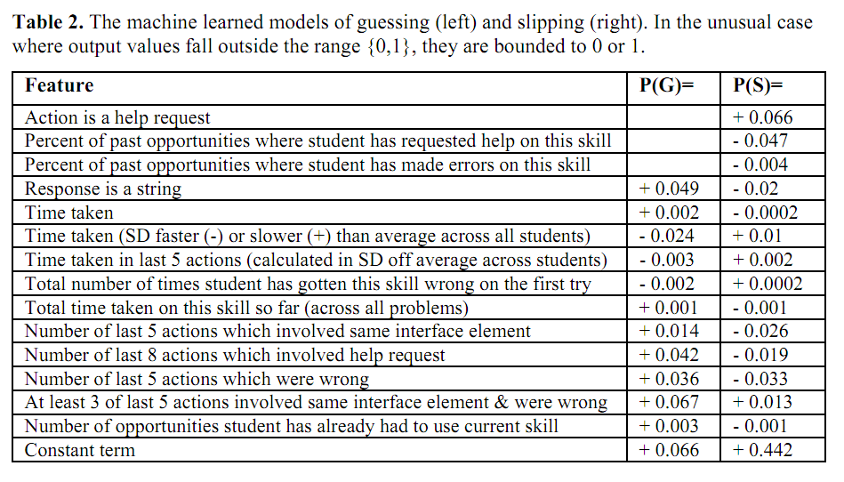
Interpretation of Models?

Slide 55
Baker, Corbett, & Aleven’s (2008) Contextual Guess and Slip model
Effect on future prediction: very inconsistent
Much better on Cognitive Tutors for middle school, algebra, geometry (Baker, Corbett, & Aleven, 2008a, 2008b)
Much worse on Cognitive Tutor for genetics (Baker et al., 2010, 2011) and ASSISTments (Gowda et al., 2011)
Any hypotheses for why?

Slide 56
That said
P(S) models transfer between data sets from different countries (San Pedro et al., 2011), and between different versions of same tutor (San Pedro et al., 2011)
Average P(S) predicts post-test (Baker et al., 2010)
Average P(S) predicts shallow learners (Baker, Gowda, & Corbett, under review)

Slide 57
That said
P(S) negatively associated with boredom, confusion (San Pedro et al., 2011)
P(S) positively associated with engaged concentration (San Pedro et al., 2011)
P(S) associated with having neither performance goals or learning goals (Hershkovitz et al., 2011)

Slide 58
What does P(S) mean?

Slide 59
What does P(S) mean?
Carelessness? (San Pedro et al., 2011)
Maps very cleanly to theory of carelessness in Clements (1982)
Shallow learning? (Baker, Gowda, & Corbett, under review)
Student’s knowledge is imperfect and works on some problems and not others, so it appears that the student is slipping
How could we tell these apart?

Slide 60
Other Contextualization Ideas?
All 4 parameters have been contextualized…
But how could they be contextualized differently?

Slide 61
Key point
Contextualization approaches do not appear to lead to overall improvement on predicting within-tutor performance
But they are useful for other purposes
Predicting robust learning
Understanding learning constructs
Notes:
Response sequence analysis of results

Slide 62
BKT with Multiple Skills

Slide 63
Conjunctive Model (Pardos et al., 2008)
The probability a student can answer an item with skills A and B is
P(CORR|A^B) = P(CORR|A) * P(CORR|B)
But how should credit or blame be assigned to the various skills?

Slide 64
Koedinger et al.’s (2011) Conjunctive Model
Equations for 2 skills

Slide 65
Koedinger et al.’s (2011) Conjunctive Model
Generalized equations

Slide 66
Koedinger et al.’s (2011) Conjunctive Model
Handles case where multiple skills apply to an item better than classical BKT

Slide 67
Other BKT Extensions?
Additional parameters?
Additional states?

Slide 68
Many others
Clustered Skills (Ritter et al., 2009)

Slide 69
Other Comments and Questions?

Slide 70
The End

